Slide 1

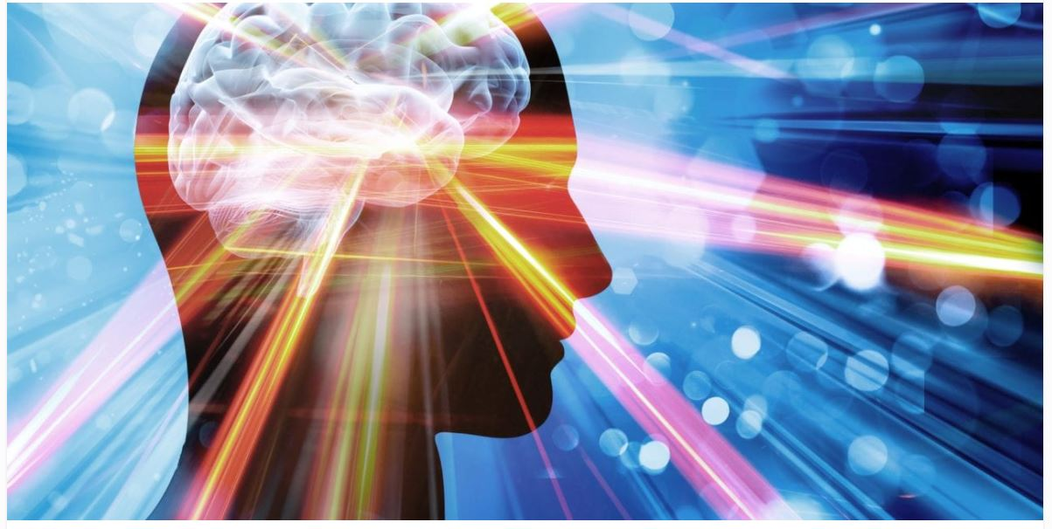
PROCESS IMPROVEMENT PROJECT
SLEEP(Self) QUALITY IMPROVEMENT

Slide 2
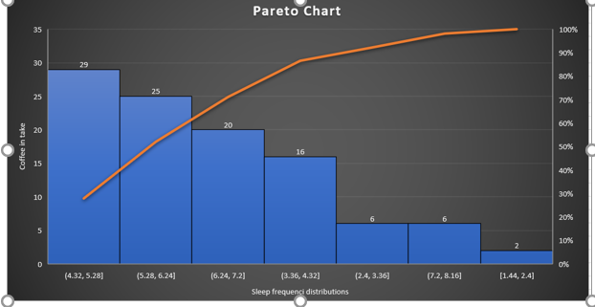
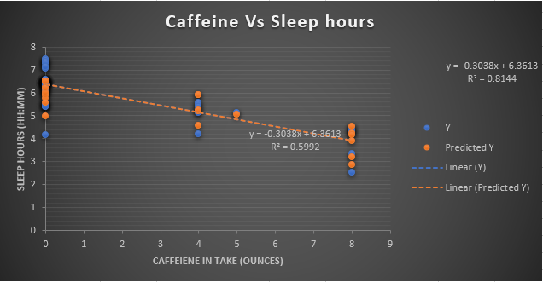
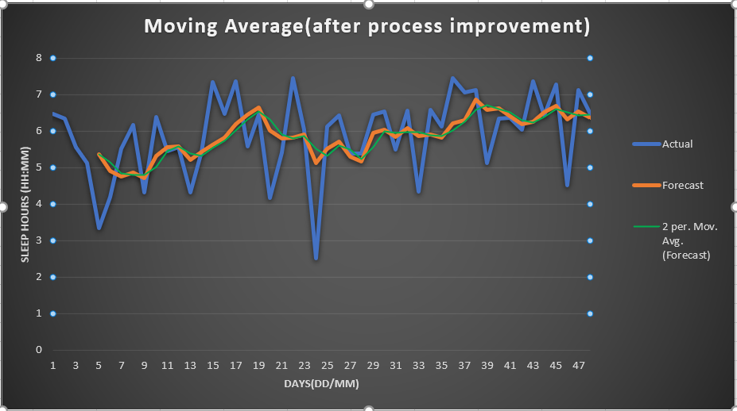
SLEEP QUALITY IMPROVEMENT PROJECT
DEFINE(14-JUL) | MEASURE (25-JUL) | ANALYZE (15-AUG) | IMPROVE | CONTROL
Average sleep was < 5.0 hrs Goal is increase the sleep average by 6.5 hrs per day Identified the past 3 months data to get the influential variables (x) Recognized them as Caffeine in take after 6 PM Screentime Key Output at the phase : SQL as 1.7 before process improvement Average mean is :4.40 | Pareto Chart: Provided an eye opener how the sleep hours are getting impacted | Chi Square and Hypothesis This provided another insight that my sleep hours are actually greater on weekends than weekdays Assume alpha 0.05 Where my p value is 0.00769 which is less than alpha | After process improvement SQL is 2.6 Which is a significant increase in my sleep hours Below representation post process improvement | I’ve considered moving average as a measure for control with this continuous data, with K as 5 After process improvement Avg increased to 5.85 hrs(SUCCESS)

Slide 3
DEFINE
DMAIC
PROBLEM STATEMENT
Lack of proper sleep during night times, effecting one’s health by-all means. I’ve been personally experiencing this from quite sometime.
Current day lifestyle impacts human sleep cycle a lot than a decade ago. The influencing factors for this are, work/job stress, lack of proper exercise, improper diet.
I'm falling behind to take appropriate measurements continuously.
I've considered caffeine in take after 6 PM, screentime before bed or while on the bed and daily exercise routine are the key parameters that are influencing my sleep (keeping aside baby care during night this is something can't be considered as impacting as it's part of life.)
Although my late work hours, and over stress or strain with rest of the day-to-day activities I've not considered them here as certain things are not measured properly
On Average I don’t sleep beyond 5.0 hrs.(y) per day.
I’ve figured out that in take of caffeine level after 6PM, Screen time after 10:00 PM, irregular exercising habits are the main key parameters besides long hours, baby care.
GOAL :
Improve the sleep hours on average of 6 hrs. per day.(i.e, Y)
Compare the influence of caffeine intake after 6 PM (i.e., f(x))
Also watch how the screentime (f(x)) is influencing sleep quality
Additionally, identify if there is any relation between weekdays to weekends in sleep hours.
PROJECT SCOPE:
Collect, extract and analyze the data both historical and current to measure the no of hours slept, caffeine in take, screentime after certain time
Target to have
60 days of prior data which is not having any reduction in coffee in take after 6 PM (Before process Improvement)
Have at least 20- 30 days of current data to have reduced or not having coffee after 6 PM
All the data elements are liquid in volume, time hence I go by the principles of applying techniques of continuous data
Coffee/ /caffeine in take in ounces
Sleep hours in hours and minutes (HH:MM)
Screen time in minutes (for ease of calculations rounding them to nearest number
Note: For instance, if the time spent is 11mm 22secs, considering as 11 min's , if it is 20mm 32 secs considered as 21 minutes
TEAM:
Self, Technology based apps, Fitbit Luxe, iPhone 11s
Out Of Scope:
Since the current project based on sleeping hours quality and I don’t have great measurements in place to convert the poor sleep index to any $$ value
I
“Sleep is the best meditation.” — Dalai Lama
Notes:
As it’s self monitoring and goal is to improve self sleep quality process, I’m giving it as Problem statement rather than business impact.
Alternatively, I would describe couple of real-life issues due to poor sleep quality thus giving an overview why I’m targeting on this

Slide 4
PROCESS MAP
DMAIC
OVERALL PROCESS MAP
The main objective of this basic process map is to provide a view about data.
This process map may not include the sleep cycle stages or the caffeine in take in a categorical manner.
Sleep Monitor HRS
START
Use Fir bit App
Collect the data
RAW OLD DATA
CURRENT DATA
Separate data in two series
Sleep hours, Caffeine
Identifies the causation, Correlation
Measure the variables behavior
ANALYZE USING
CONTROL
DPMO
Descriptive Statistics
Pareto Chart
Trend Analysis, CI
Utilize the regression techniques and figure the relation and derive Y=f(x)

Slide 5
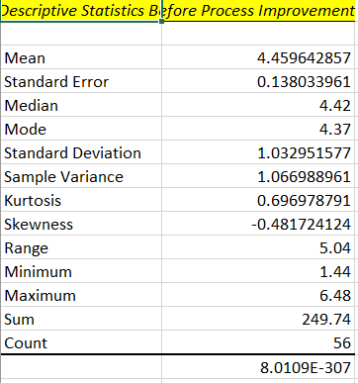
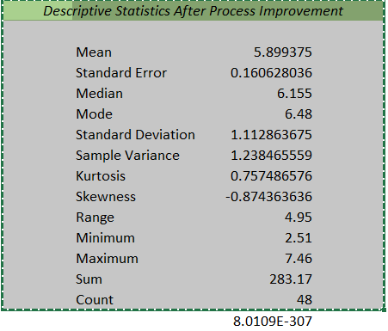
DESCRIPTIVE STATISTICS (Before & After)
DMAIC
For better results I’ve chosen 56 days (8 weeks) of before process improvement data so that large data provides better sampling in further sections
Considered the thoroughly monitored and reduced caffeine influence after 6 PM
Took 6 weeks (48 days) of data

Slide 6
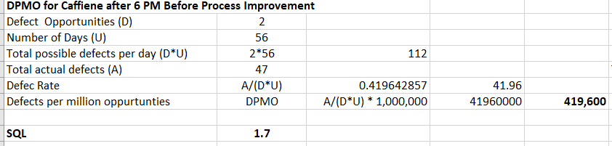
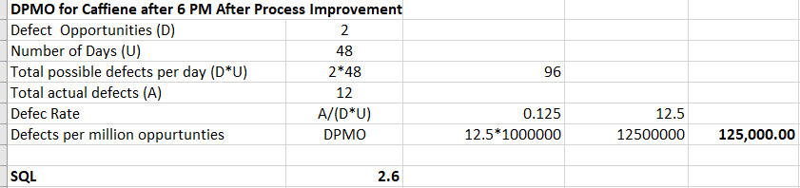
DPMO & SQL (Before & After)
DMAIC
I've considered that, 2 defects per each cup, each day, even
Defect-1,
though the cup says 8 ounces, sometimes we may not actually fill the cup –
Defect 2- Not all the times cup will be emptied, there might be some leftovers
Included the whole days that are considered
This I've considered the days I've actually took coffee after 6 PM even, before the process improvement
SQL after process improvement has increased to 2.6, This shows the process followed to improve the quality of sleep in right direction
Increased SQL
Notes:
Since the data is mostly continuous I couldn’t get idea how to implement Kappa Technique to draw the measurement error if any.

Slide 7
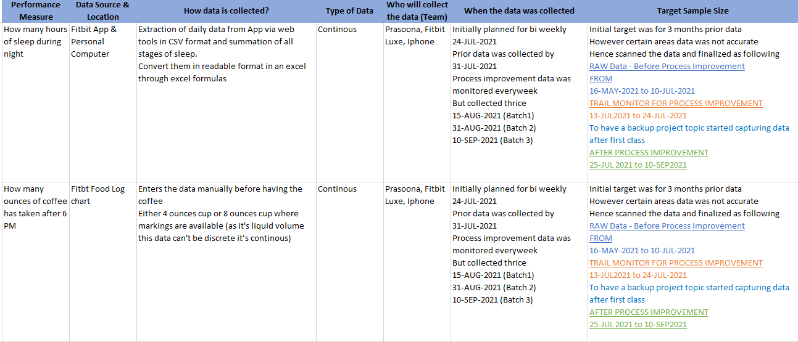
DATA MEASUREMENT PLAN
DMAIC

Slide 8
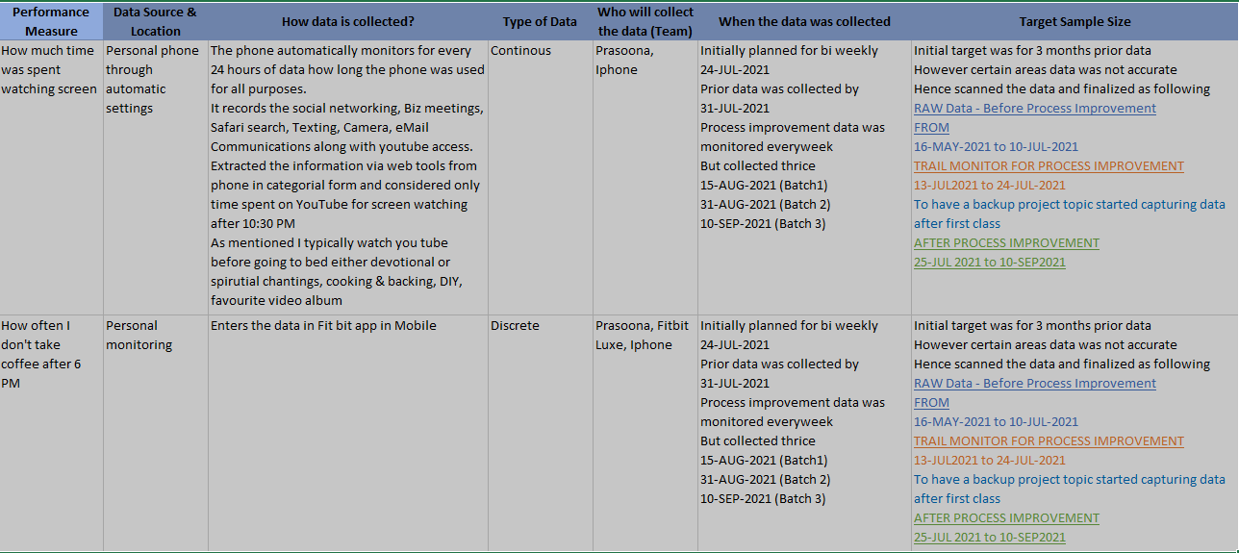
DATA MEASUREMENT PLAN(Continued)
DMAIC

Slide 9
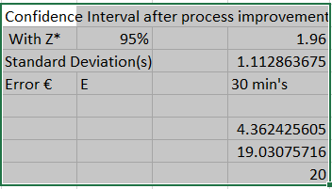
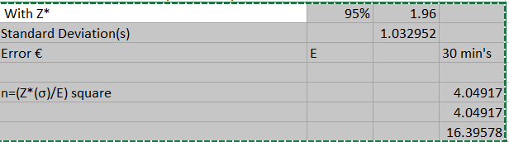
Sample Size & Confidence Interval
DMAIC
Collection and attaining the data to the readable format is a kind of challenge which is typical with different types of apps and devices.
The real test is how much data we can utilize what amount of data provides the accurate output to draw conclusions
As detailed out in data measurement plan after getting the data in useful mode I’ve done the most useful technique of calculating the Confidence Interval for Continuous data and achieved the sample size.
Before process Improvement(Approximately ~ 17)
Since the data is mostly continuous, I couldn’t get idea how to implement Kappa Technique to draw the measurement error if any.
Like wise I tried to get the non value attribute and valuable attribute information for better process improvement. I tried that with “Screentime” data that I’ve collected,
That data was categorical across all actions performed with mobile phone, it was very tedious job to segregate the meaningful non valuable time spent on.
Notes:
Since the data is mostly continuous, I couldn’t get idea how to implement Kappa Technique to draw the measurement error if any.
Like wise I tried to get the non value attribute and valuable attribute information for better process improvement. I tried that with “Screentime” data that I’ve collected,
That data was categorical across all actions performed with mobile phone, it was very tedious job to segregate the meaningful non valuable time spent on.

Slide 10
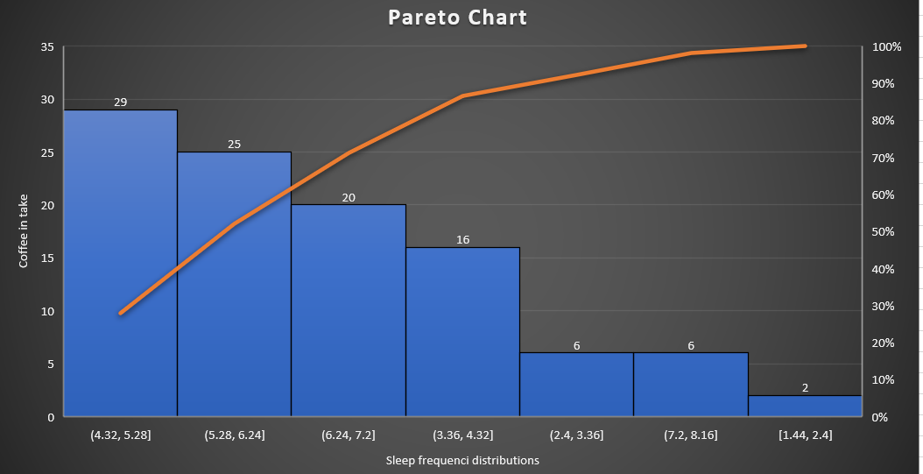
PARETO CHART
DMAIC
Pareto chart measurement is really helpful and handy to derive certain understandings in a logical manner
The graph touches 100% of the frequency when my caffeine in take was 8 ounces and after 6 PM
This also provides an insight how caffeine influence is impacting the sleep patterns

Slide 11
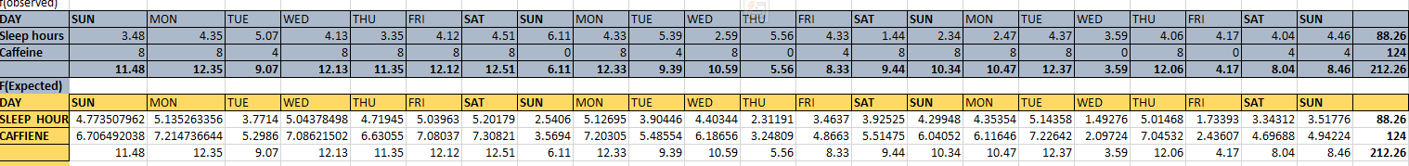
CHI SQUARE TEST
DMAIC
Based on the learnings in the class in wished to experiment my project with the “hypothesis” and will it give me the result instead of testing with caffeine influence, I did with days of the week and weekends.
Hypothesis Statement
I did the analysis by taking the sample size of “22” days as the approximate good value to calculate is 20 from the sample size calculations in measure phase

Slide 12
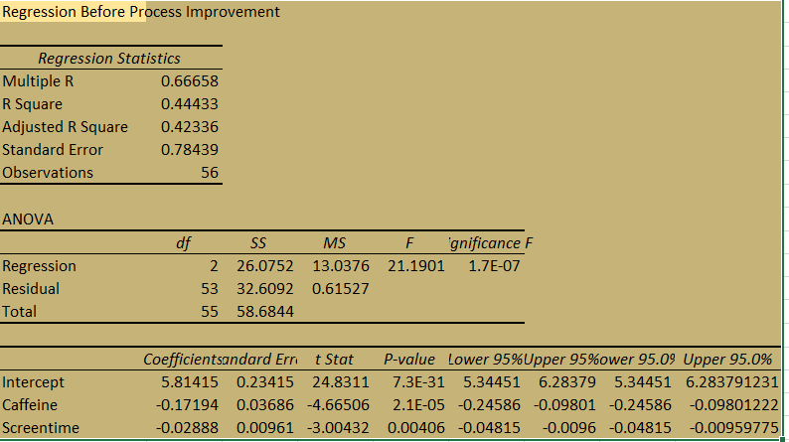
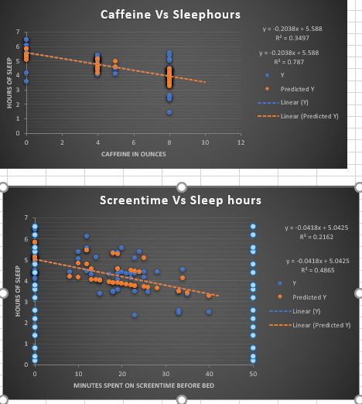
Regression Before Process Improvement

Slide 13
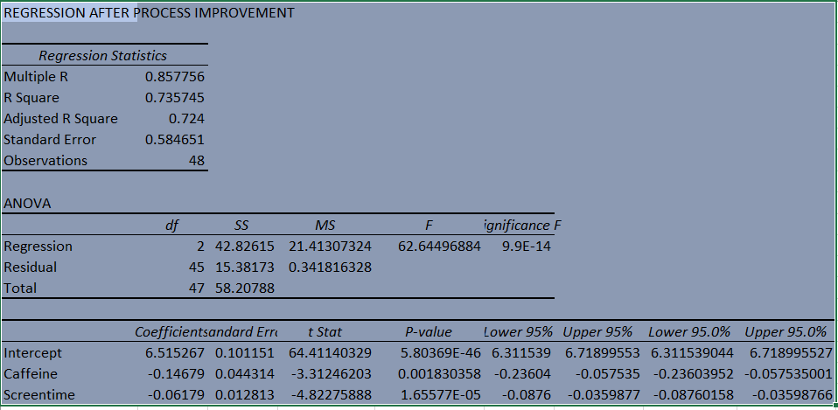
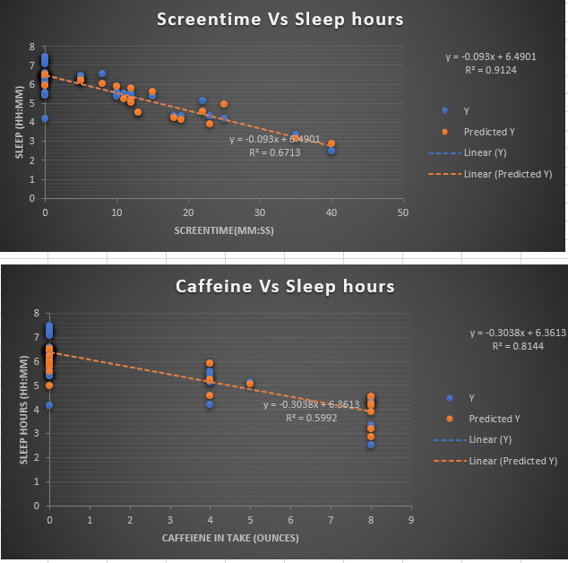
Regression After Process Improvement
DMAIC
I’ve considered the caffeine influence vs sleep hours in the define, measure and analyze.
In the improve phase I wished to view the results for both the (caffeine and screentime) influence on the sleep hours
The p value suggests that both have the influence.
The inferential statistics also provides the R square and the linear coefficient
By observing both the charts before and after process improvement, one can identify the change in sleep quality based on process improvement(reduction in caffeine in take and spending time on mobile after 10:30 PM)

Slide 14
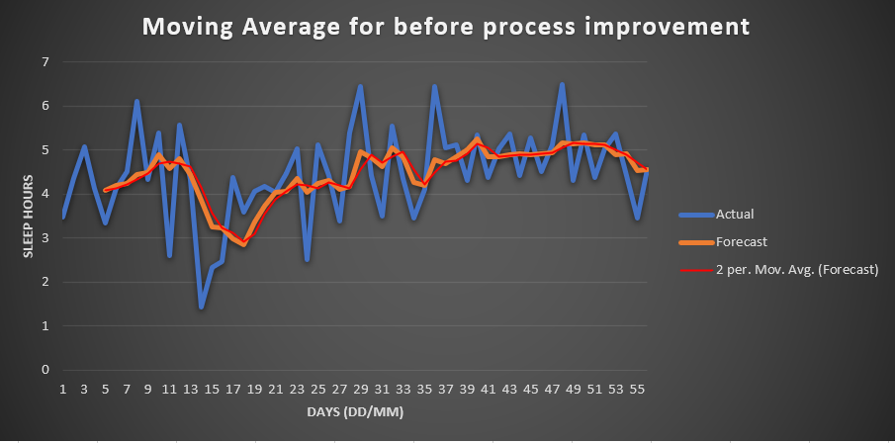
Moving Average
Thus the four phases (define, measure, analyze and improve) provided a great insight what was actually getting impacted and how the input variables are influencing output.
Now we are in the final phase of control, as we came to know from improve phase, we can now experiment how we can control the input variables, so that we can predict the upcoming days sleep quality or trend based on the improvement measures we took
As it’s a continuous data I preferred to use “Moving Average” for the better control process of the data with K =5.
DMAIC

Slide 15
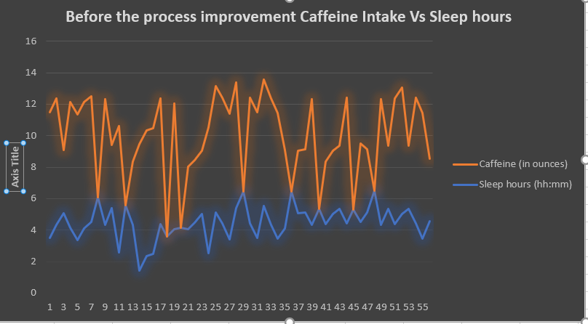
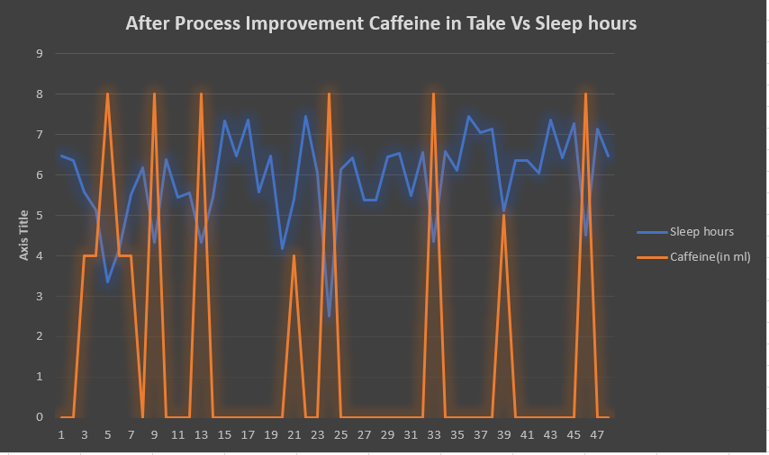
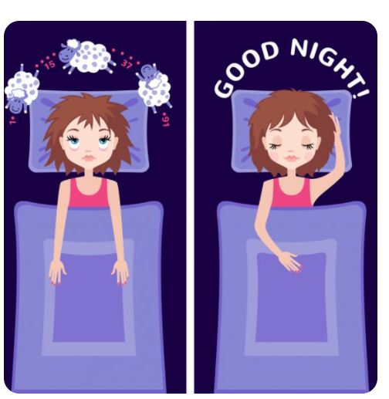
Conclusion: Overall Combination Chart(Bar Charts)
The fact is that, with the process improvement the average sleep hours are increased in the range of 5.89 hrs, which is huge success.
It’s 20% increase in my average sleep hours
Further, improve my lifestyle and work style I can have a quality sleep, have longer hours of sleep during weekends
Did I achieve my Goal after process improvement?
“YES”

Slide 16
What are measures taken
Did I really stopped taking coffee in take after 6 PM?
Ans: YES, however switched to herbal tea of only “4 ounces” with 5.00 to 5.15 PM
How about screentime?
The answer is “YES” for this to have the realistic data for the project purpose I did experiment these few days, and the results are really great, my wake time due to sudden dreams are reduced.
This determination is done by FitBit Sleep track
Lessons Learnt
Applying the concepts to the large and real data requires to have prerequisites
Data clean up
What data to be used and how the sample size plays an important role in identifying the problem
The Z test concept I couldn’t apply to my data somewhere I was missing some information and always got a negative result all the time my data went below LCL

Slide 17
Appendix & Credits
Google.com
pittsburgh-sleep-quality-index, amerisleep blog
https://www.sleepresearchsociety.org/
https://www.sleepfoundation.org/
https://www.helpguide.org/articles/sleep/getting-better-sleep.htm
https://en.wikipedia.org/wiki/Sleep
http://clipart-library.com/
https://assets.cdn.thewebconsole.com/S3WEB8659/images/Dr-Steven-Lin---the-five-stages-of-sleep-and-brain-wave-cycles.pdf
https://www.psychologytoday.com/us/blog/between-you-and-me/201307/your-sleep-cycle-revealed
https://www.sleepreviewmag.com/sleep-health/prevailing-attitudes/academies-associations/sleep-research-society-announces-2020-award-recipients/
http://www.opapc.com/uploads/documents/PSQI.pdf
https://www.nwsleephealth.com

